Slide 1

Text Mining Overview
Nuno Escudeiro, nfe@isep.ipp.pt

Slide 2
Outline
Introduction to text mining
Text modeling, bag-of-words, TFxIDF
Text processing
Tools for text mining
R language, tm package
Case study
Hands-on contest

Slide 3
INTRODUCTION

Slide 4
Intro|Models|Processing|Tools|R|Case study|Handson
Motivations
Data mining: finding valuable patterns in data
big data
availability of text in digital form
high volume vs high quality
NLP, hand-made rules, scalability
Data mining methods expect highly structured datasets

Slide 5
Intro|Models|Processing|Tools|R|Case study|Handson
Traditional data mining
structured (tabular form)
numbers
understandable by domain specialists
descriptive attributes are permanent, known in advance and may be based on prior design
all examples are described by the same set of attributes
numerical (greater than, less than) / categorical (list of unordered codes) attributes
all the possible values of a given attribute are known in advance and recorded uniformly for every example
semantic of attributes is invariant
adding a new example is adding a new row with a vector of measures for each of the attributes
examples are rows, datasets are matrices, mathematical methods are aplicable
Motivations
Data mining: finding valuable patterns in data
big data
availability of text in digital form
high volume vs high quality
NLP, hand-made rules, scalability
Data mining methods expect highly structured datasets

Slide 6
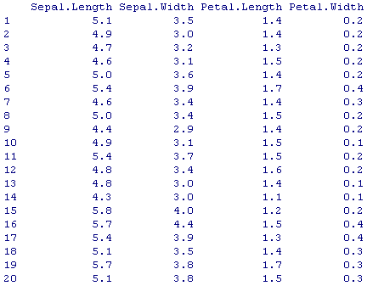
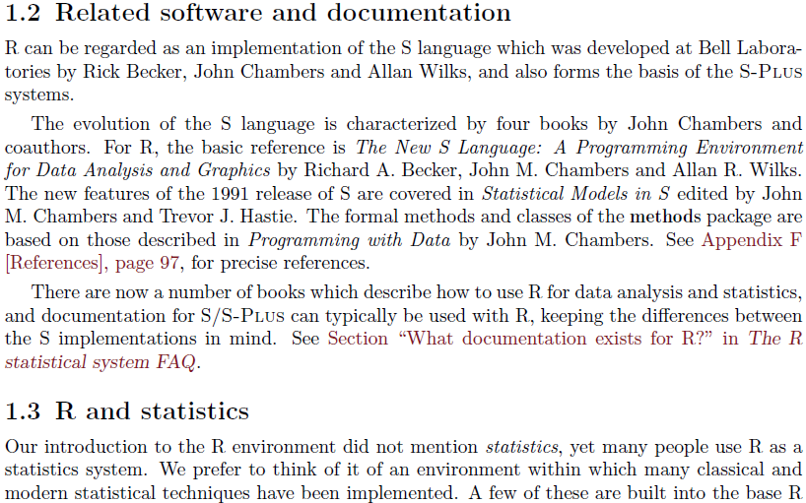
Intro|Models|Processing|Tools|R|Case study|Handson
Traditional data mining
structured (tabular form)
numbers
understandable by domain specialists
descriptive attributes are permanent, known in advance and may be based on prior design
all examples are described by the same set of attributes
numerical (greater than, less than) / categorical (list of unordered codes) attributes
all the possible values of a given attribute are known in advance and recorded uniformly for every example
semantic of attributes is invariant
adding a new example is adding a new row with a vector of measures for each of the attributes
examples are rows, datasets are matrices, mathematical methods are aplicable
Motivations
Data mining: finding valuable patterns in data
big data
availability of text in digital form
high volume vs high quality
NLP, hand-made rules, scalability
Data mining methods expect highly structured datasets

Slide 7
Intro|Models|Processing|Tools|R|Case study|Handson
Traditional data mining | Text mining
structured (tabular form) | non-structured (free form)
numbers | text
understandable by domain specialists | readable, meaningful to non-specialists
descriptive attributes are permanent, known in advance and may be based on prior design | descriptive attributes of a text are the words in it (alone?, in pairs?), document structure, letter case, letter format, metadata (in which case we turn to the classical paradigm)
all examples are described by the same set of attributes
numerical (greater than, less than) / categorical (list of unordered codes) attributes
all the possible values of a given attribute are known in advance and recorded uniformly for every example
semantic of attributes is invariant | semantics depends on linguistic matters such as context and grammar.
adding a new example is adding a new row with a vector of measures for each of the attributes
examples are rows, datasets are matrices, mathematical methods are aplicable
Motivations
Data mining: finding valuable patterns in data
big data
availability of text in digital form
high volume vs high quality
NLP, hand-made rules, scalability
Data mining methods expect highly structured datasets

Slide 8
Intro|Models|Processing|Tools|R|Case study|Handson
Motivations
Natural Language Processing (NLP)
- linguistic approach
- hand-written rules
- theasaurus, lexical databases (e.g. WordNet - http://wordnet.princeton.edu/ )
- demands for specialists in linguistics
- some applications of NLP
i) question answering
ii) automatic translation
iii) text summarization
iv) sentence parsing
Statistical methods perform well on these problems!.

Slide 9
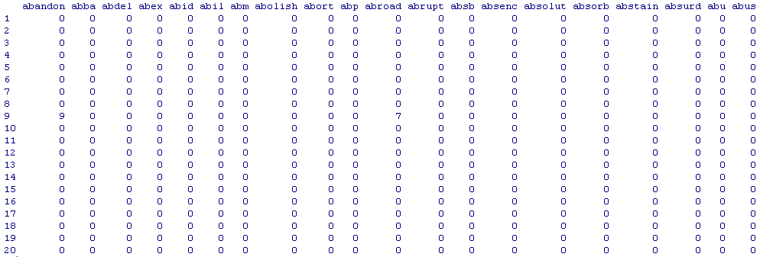
Intro|Models|Processing|Tools|R|Case study|Handson
From text to numbers
Each word is a descriptive attribute
Word frequency
Sparse matrices
High number of attributes (easily reach 10³ - 10⁵)
To be or not to be
be | or | not | to
2 | 1 | 1 | 2

Slide 10
Intro|Models|Processing|Tools|R|Case study|Handson
Applications
- Document classification (text categorization)
- Clustering and organizing a collection of documents (corpus)
- Information retrieval (document matching, search engines, document similarity)
- Information extraction (NER, summarization).

Slide 11
TEXT MODELING

Slide 12
Intro|Models|Processing|Tools|R|Case study|Handson
Bag-of-word models
- Boolean
- Vector space (assumes independence of index terms)
i) TF (Term Frequency)
ii) TFxIDF (Term Frequency x Inverse Document Frequency)
iii) Entropy weighting
- Generalized vector space (co-occurence induces dependency)
- N-grams (index terms are groups of n-words or n-chars rather than single words)

Slide 13
Intro|Models|Processing|Tools|R|Case study|Handson
Structured models (mainly used for IR)
Non-overlapping list model (lists of non-overlapping text regions)
Proximal nodes model (set of independent hierarchical indexing structures)
Path prefixing (hypertext, prefixing words/phrases with their html tags)
Relational model (represents corpora in a relational schema including relations like ContainsText(domNode, text) PartOf(domNode, domNode) LinksTo(scrDomNode, dstDomNode))

Slide 14
TEXT PROCESSING

Slide 15
Intro|Models|Processing|Tools|R|Case study|Handson
Text processing
Pre-processing
The pre-processing stage comprises the tasks that are required to obtain a suitable document representation, valid for the subsequent automatic learning phase. This stage includes text preparation and text representation.
Learning
Infering knowledge using adequate machine learning algorithms depending on the task at hand.
Generalizing
Applying the infered model to new examples.
Presenting
Presenting results.

Slide 16
Intro|Models|Processing|Tools|R|Case study|Handson
Pre-processing stage:
Text preparation: takes a text document as input and returns a set of features describing it. This phase includes several steps that attempt to eliminate non-informative features and might involve some or all of the following tasks´:
Tokenization – breaking the text document into tokens, commonly words; includes all sorts of lexical analysis steps, such as: eliminating punctuation, eventually numbers, accents and extra spacing, converting to lower/upper case
Stop-word removal – removing irrelevant terms; requires a list of stop-words (words to eliminate)
Stemming or lemmatization – reducing words to their semantic root; the Porter algorithm
Text representation: the full process of selecting features and computing their weights is known as indexing.
Feature selection – defining index terms, the features that will be used for document modeling (vocabulary)
Computing index term weight

Slide 17
Intro|Models|Processing|Tools|R|Case study|Handson
Pre-processing stage:
The tasks performed during the pre-processing stage depend on the model that will be used to represent text.
The application of these pre-processing tasks must be carefully done because the predictive power of words is highly dependent on the topic of interest.
Another essential aspect to consider is the language in which the document is written, which determines, at least, the list of stop-words and the stemming algorithm to use.
Stop-words removal is controversial. Removing words from a text, even those that in a linguistic sense have low semantic value, always reduces the information contained in the text document. Stop-word removal reduces the dimensionality of the feature space at a cost of loosing some information. A compromise solution must be set so that this information loss does not becomes counterproductive.
To be or not to be.
Stop word removal
.

Slide 18
Intro|Models|Processing|Tools|R|Case study|Handson
Pre-processing stage:
D1: A student is a learner, or someone who attends an educational institution.
D2: The average age of higher education students is 29.
Tokenization:
D1: a student is a learner or someone who attends an educational institution
D2: the average age of higher education students is
Stop-word removal:
D1: student learner someone who attends educational institution
D2: average age higher education students
Stemming:
D1: student learn someone who attend education institution
D2: average age higher education student
Indexing:
Which words would you remove from the vocabulary below if the purpose is to distinguish between D1 and D2?
 | age | attend | average | education | higher | institution | learn | someone | student | who
D1 | 0 | 1 | 0 | 1 | 0 | 1 | 1 | 1 | 1 | 1
D2 | 1 | 0 | 1 | 1 | 1 | 0 | 0 | 0 | 1 | 0

Slide 19


Intro|Models|Processing|Tools|R|Case study|Handson
Vector model – TFxIDF:
the term frequency factor, TF, a measure of intra-cluster similarity; computed as the number of times that the term occurs in the document, normalized in a way as to make it independent of document length and
the inverse document frequency factor, IDF, a measure of inter-cluster dissimilarity; weighs each term according to its discriminative power in the entire collection.

Slide 20
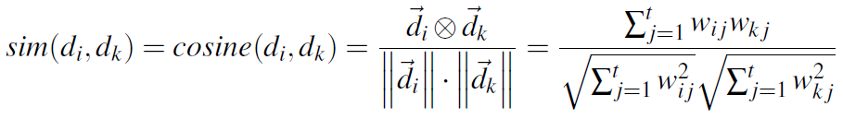
Intro|Models|Processing|Tools|R|Case study|Handson
Vector model – cosine similarity:
Q: higher education student age
 | age | attend | average | education | higher | institution | learn | someone | student | who
D1 | 0 | 1 | 0 | 1 | 0 | 1 | 1 | 1 | 1 | 1
D2 | 1 | 0 | 1 | 1 | 1 | 0 | 0 | 0 | 1 | 0
Q | 1 | 0 | 0 | 1 | 1 | 0 | 0 | 0 | 1 | 0
 | Q
D1 | 0.38
D2 | 0.76

Slide 21
Intro|Models|Processing|Tools|R|Case study|Handson
Text processing functions
Part-Of-Speech (POS) tagging (gramatical class of words: verb, noun, adverb, …)
Named Entity Recognition (NER) (recognition of types of noun phrases: persons, places, organizations, dates, …)
Parsing (finding the relations of a single word in a sentence to all others and its function: subject, object, …)
Word sense disambiguation (semantics, identify word meaning)
Phrase recognition (group individual tokens into units)

Slide 22

Intro|Models|Processing|Tools|R|Case study|Handson
Evaluation
Precision
Defined as the ratio between the number of documents correctly classified and the total number of documents classified in the category
Recall
Defined as the ratio between the number of documents correctly classified and the total number of documents in the category
F-measure
The F-measure combines recall and precision in a unique indicator. F1 gives the same weight to precison and recall.
Accuracy, Error
Complementary measures of the error probability of the classifier given a certain category. Accuracy is defined as the ratio of the number of correctly classified examples by the total number of evaluated examples, while error is defined as the ratio of the number of incorrectly classified examples by the total number of evaluated examples.

Slide 23
Intro|Models|Processing|Tools|R|Case study|Handson
Evaluation
These measures are defined for binary classifiers. To measure performance in multi-class problems there are two common approaches that aggregate the measures evaluated at each singular class: macro-averaging and micro-averaging.
Macro-averaged measures are obtained by first computing the individual scores, for each individual class, and then, averaging these scores to obtain the global measure.
Micro-averaging measures are obtained by first computing the individual scores of each document and then computing their average.
There is an important distinction between these two forms of aggregation : macro-averaging gives equal weights to all classes while micro-averaging gives equal weight to every document.
Micro-average
Same weight to all documents
Macro average
Same weight to all categories

Slide 24
TOOLS FOR TEXT MINING

Slide 25
Intro|Models|Processing|Tools|R|Case study|Handson
R, tm package – http://www.r-project.org/
Mallet – http://mallet.cs.umass.edu/
Lucene – http://lucene.apache.org/
OpenNLP – http://opennlp.apache.org/
RapidMiner – http://rapid-i.com/

Slide 26
R LANGUAGE, TM PACKAGE

Slide 27
Intro|Models|Processing|Tools|R|Case study|Handson
R is an integrated suite of software facilities for data manipulation, calculation and graphical display.
Among other things it has an effective data handling and storage facility, a suite of operators for calculations on arrays, in particular matrices, a large, coherent, integrated collection of intermediate tools for data analysis, graphical facilities for data analysis and display and simple and effective programming language which includes: conditionals, loops, user defined recursive functions and input and output facilities.
R prompt
>
Quitting R
> q()
Help
> ?command or >help(command)
R is case sensitive

Slide 28
Intro|Models|Processing|Tools|R|Case study|Handson
Comments
# content ignored up to the next newline
Char constant
“this is a char constant”
Elementary commands, separated by ‘;’ can be grouped together into one compound expression by braces (‘{’ and ‘}’).
Some useful commands:
> ls()
> rm()
Assignment operator:
> x <- 3 #local
> x <<- 3 #global
Coercion, change of mode, casting
as.numeric(), as.character(), as.matrix(), ...

Slide 29
Intro|Models|Processing|Tools|R|Case study|Handson
R operates on named data structures. The simplest such structure is the numeric vector, which is a single entity consisting of an ordered collection of numbers.
> x <- c(10.4, 5.6, 3.1, 6.4, 21.7)
Vector arithmetic
> v <- 2*x + y + 1
Elementary arithmetic operators:
+ - * / ^
Arithmetic functions:
log(), exp(), sin(), cos(), sqrt(), sum(x), max(x), min(x), length(x)
Indexing:
> x <- c(43, 67, 23, 12, 87)
> x
[1] 43 67 23 12 87
> x[2]
[1] 67

Slide 30
Intro|Models|Processing|Tools|R|Case study|Handson
Other types of objects (besides vectors):
matrices or more generally arrays are multi-dimensional generalizations of vectors.
> m[1,1]
> m[1,]
factors provide compact ways to handle categorical data. A factor is a vector object used to specify a discrete classification (grouping) of the components of other vectors of the same length.
lists are a general form of vector in which the various elements need not be of the same type, and are often themselves vectors or lists.
> x <- list()
> x[[1]] <- c(1,2,3)
data frames are matrix-like structures, in which the columns can be of different types
> planets <- data.frame(name=planets, temperature=tc)
> planets[,1] or planets$name or planets[,"name"]
functions are themselves objects in R which can be arguments to other functions
> d <- function(x, y) {sqrt(sum((x-y)^2))}
> d(0,c(1,1,1))
> [1] 1.732051

Slide 31
Intro|Models|Processing|Tools|R|Case study|Handson
Control statements: IF
if (expr_1) expr_2 else expr_3
if(i == 1) {
sed.ks[i] <- NA
} else {
sed.ks[i] <- f.stop.sedks(prev.post, post, udIdx)
}

Slide 32
Intro|Models|Processing|Tools|R|Case study|Handson
Control statements: FOR
for (name in expr_1) expr_2
for(j in 1:nrow(ad)) {
for(k in 1:length(itkc)) {
ipd[j,k] <- post[uIdx[j], itkc[k]] / ad[j,k]
}
}

Slide 33
Intro|Models|Processing|Tools|R|Case study|Handson
Control statements: WHILE
while (condition) expr
while (length(unlabeledIdx) != 0) {
labeledIdx <- union(labeledIdx, query[i])
unlabeledIdx <- setdiff(trainingIndex, labeledIdx)
i <- i + 1
}

Slide 34
Intro|Models|Processing|Tools|R|Case study|Handson
R PACKAGES
All R functions and datasets are stored in packages. Only when a package is loaded are its contents available.
To see which packages are installed at your site, issue the command:
> library()
To install packages:
> install.packages()
To load a particular package (e.g., the text mining package), use:
> library(tm)
or
> require(tm)
To see which packages are currently loaded, use:
> search()
R-intro

Slide 35
Intro|Models|Processing|Tools|R|Case study|Handson
TEXT PROCESSING: tm PACKAGE
A modular, extensible, thoroughly designed text mining infrastructure for R.
Pre-processing: data import, stemming, stopword removal, part of speech tagging, synonyms, . . .
Basis analysis techniques: count based evaluation, text clustering, text classification, . . .
Access to more advanced functionality: full integration with string kernels, latent semantic analysis, . . .
Export of term-document matrices: basically all methods in R working on matrices

Slide 36
Intro|Models|Processing|Tools|R|Case study|Handson
TEXT PROCESSING: tm PACKAGE
> removeNumbers()
> removePunctuation()
> tokenizer()
> stemDocument()
> Dictionary()
> DocumentTermMatrix()
> termFreq()
> tm_intersect()
> findFreqTerms()
> removeSparseTerms()
…
tm reference

Slide 37
CASE STUDY

Slide 38
Intro|Models|Processing|Tools|R|Case study|Handson
# load corpus
reviews <- Corpus(DirSource("./reviews"), readerControl = list(reader = readPlain, language = "english", load = TRUE))
# generate vector space model, computing index term’s weights TF
dtm <- DocumentTermMatrix(reuters)
# CHECK IT
inspect(reviews)
inspect(reviews[1])
str(dtm)
colnames(dtm) # YOU

Slide 39
HANDS-ON TEXT MINING

Slide 40
Intro|Models|Processing|Tools|R|Case study|Handson
R PACKAGES
Install R
Install required libraries
tm -- text mining
SnowballC -- stemming
RWeka -- N-gram tokenizer
e1071 -- svm
class -- knn

Slide 41
Intro|Models|Processing|Tools|R|Case study|Handson
THE CONTEST
Get a review, guess if it is a positive or negative review
Building a text classifier
Group the reviews by game (Classification? Clustering? ??)
Everything is valid:
Stop word removal
Removal of non-useful words (low frequency/high frequency)
Re-weighting
Stemming
POS tagging
N-grams
Correlation between terms and topics
More data, Less data
Use of Wordnet
Other classification algorithms (neural networks, decison trees, …)
…
https://www.dropbox.com/sh/zeb9iqiy9u0isdx/_EhjMTTRXL
http://www.metacritic.com/game/pc

Slide 42
LOWEST ERROR SO FAR: 100%

